Slide 1
GRADE-X
ECONOMICS
SECTORS IN INDIAN ECONOMY

Slide 2
Prepare a detailed report on impact of Chinese product on Indian product.

Slide 3
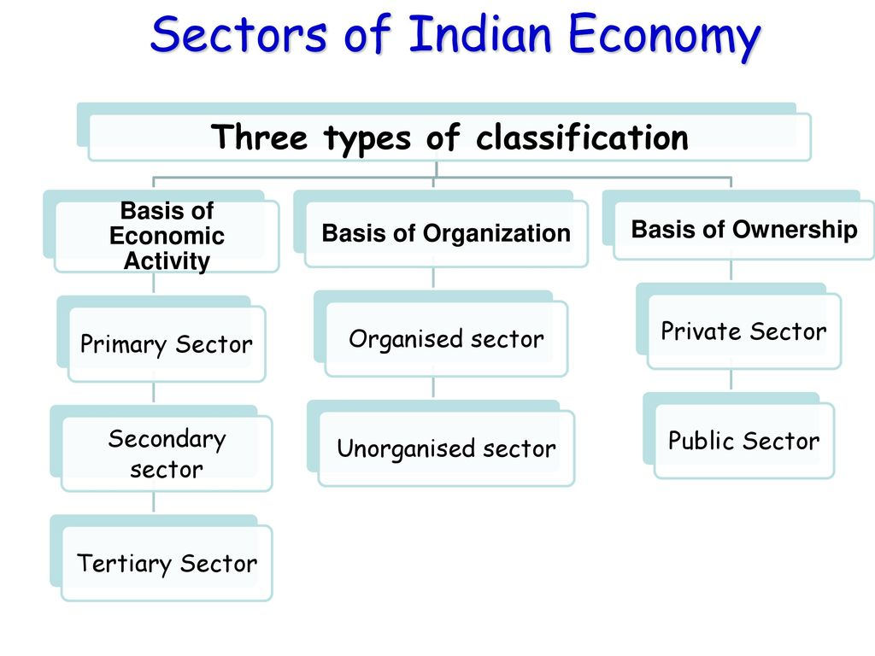

Slide 4
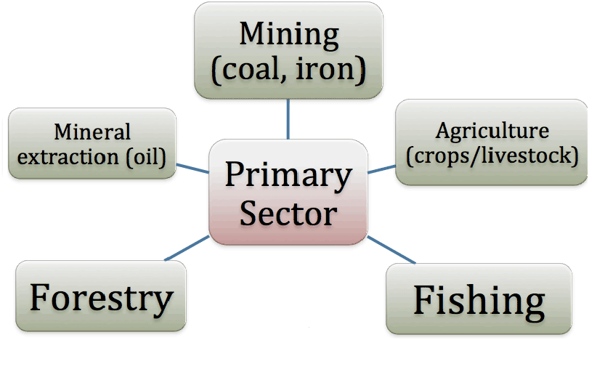

Slide 8
CONTENT SLIDE

Slide 11
Questions related to the above slides: 1) Define a primary and a secondary sector. 2) Define GDP. 3) How is tertiary sector different from other sectors?
3/8/2020
SECTORS IN INDIAN ECONOMY/GRADE-X./ECONOMICS/Mrs Sujatha/SNS ACADEMY

Slide 17
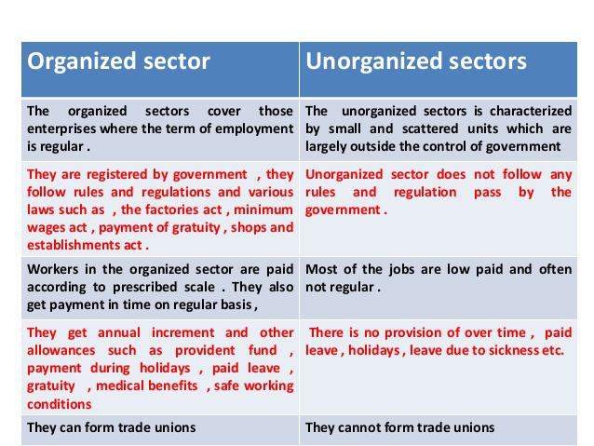

Slide 18
1/8/2020
SECTORS IN INDIAN ECONOMY/GRADE-X./ECONOMICS/Mrs Sujatha/SNS ACADEMY

Slide 20
3/8/20
SECTORS IN INDIAN ECONOMY/GRADE-X./ECONOMICS/Mrs Sujatha/SNS ACADEMY

Slide 21
Questions related to the above slides: 1) ‘Tertiary sector is not playing any significant role in Indian economy’. Do you agree? Give reasons in support of your answers. 2) Compare the employment conditions in the organised and unorganised sectors.
3/8/20
SECTORS IN INDIAN ECONOMY/GRADE-X./ECONOMICS/Mrs Sujatha/SNS ACADEMY

Slide 22
References: https://www.youtube.com/watch?v=jNvgkrjn2fI https://www.youtube.com/watch?v=7aUjw5sRzBU&list=RDCMUC8gnlsed8PJ1nwURyacjzzA&start_radio=1&t=0&t=0
3/8/20
SECTORS IN INDIAN ECONOMY/GRADE-X./ECONOMICS/Mrs Sujatha/SNS ACADEMY

